Slide 1

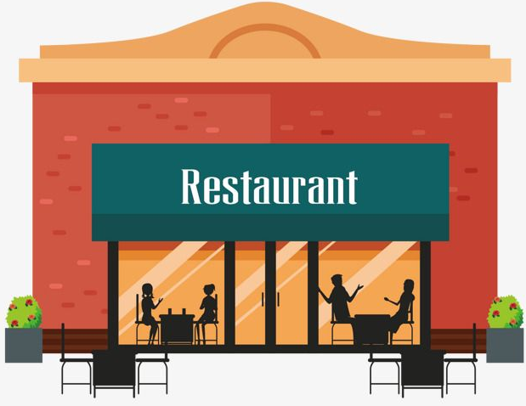
Using Yelp to Predict Restaurant Closure
By: Charlie Lee

Slide 2

Problem Statement
90% of the guests check our restaurant online prior to dining
60% hospitality facilities fail in 3 years – Regardless of + reviews, ratings, and good location
From the restaurant owners, banks, and investors’ perspective, can we predict restaurant closure based on user’s input in Attribute and Categories on Yelp platform?

Slide 3
Dataset
Yelp (https://www.yelp.com/dataset)
The dataset contains over 8 million user reviews, 160,000 businesses, and 1.2 million business attributes like hours, parking, availability, and ambience in 10 metropolitan areas.
Two different JSON dataset used
Business
Reviews

Slide 4
Data Wrangling and Cleaning
Extracted information from nested JSON dataset
Null values in attribute columns were replaced with ‘Not listed’
The owner had the choice to define either as True or False
Filtered for only restaurants, no other businesses
Final result
From 160,585 businesses to 61,328 restaurants (open and closed)

Slide 5
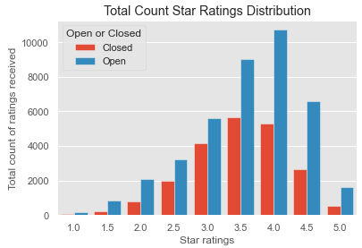
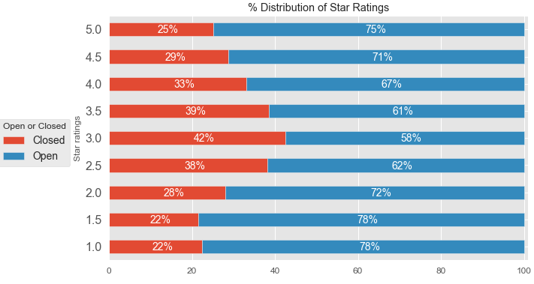
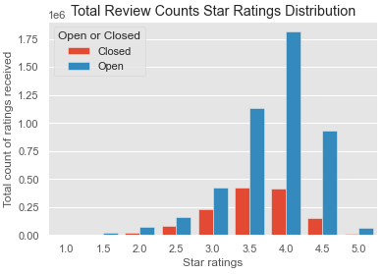
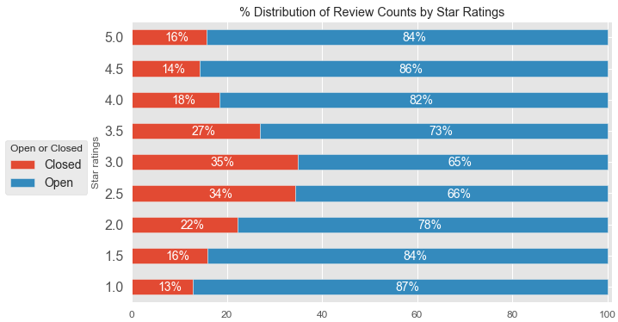
Exploratory Data Analysis (1)
Open vs. closed star ratings
Open vs. closed reviews

Slide 6
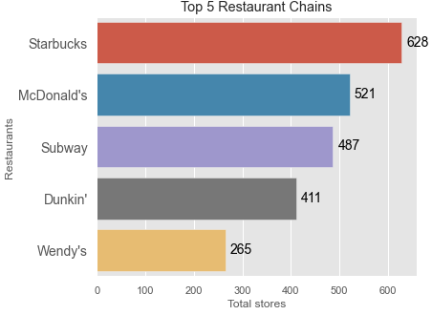
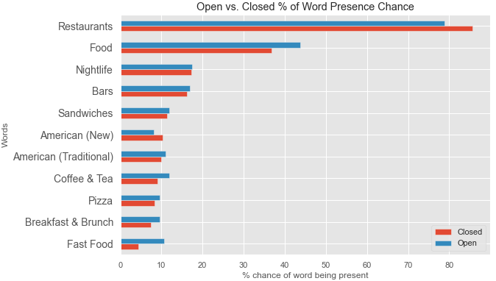
Exploratory Data Analysis (2)
Five largest restaurant chains
Open vs. Closed Top 10 Appearing Words in ‘categories’

Slide 7
Inferential Statistics (1)
Chi-square test for independence
Null hypothesis was rejected if p-value was less than 0.05 and if chi statistic was greater than the critical value
Post Hoc Test – Bonferroni
P-value adjusted according to Bonferroni correction
Multicollinearity
Touristy, hipster, romantic, intimate, and upscale attributes
Touristy chosen based on SelectKBest (chi2 scoring)

Slide 8
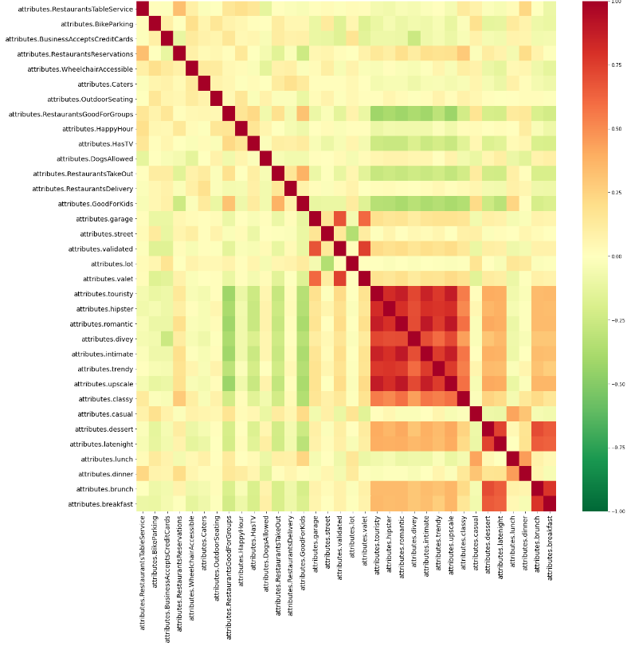
Inferential Statistics (2)

Slide 9
Machine Learning - Attributes (1)
Imbalanced Dataset
21,428 closed restaurants
39,900 open restaurants
1 to 1.86 ratio
Class weight vs. Upsampling
F-1 score used for model performance
30% test, 70% training, stratified

Slide 10
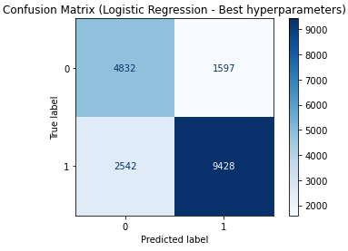
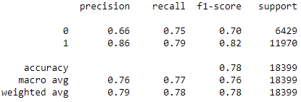
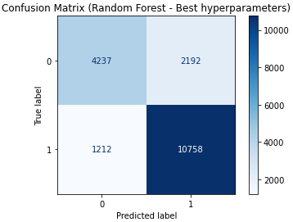
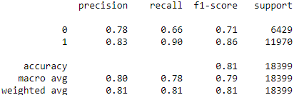
Machine Learning - Attributes (2)
Logistic Regression
Random Forest

Slide 11
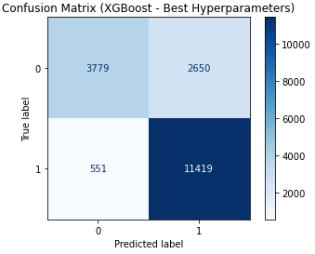
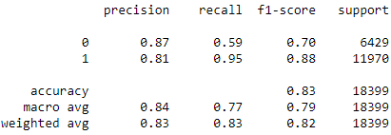
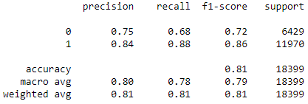
Machine Learning - Attributes (3)
XGBoost
Keras

Slide 12
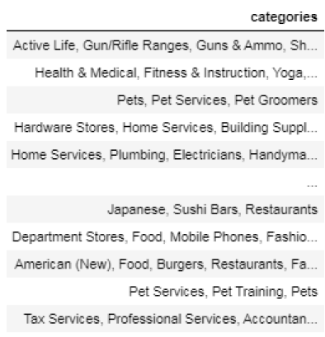
Machine Learning - Categories(1)
Natural Language Processing (NLP)
CountVectorizer used instead of TfidVectorizer
Not interested in frequency of the words

Slide 13
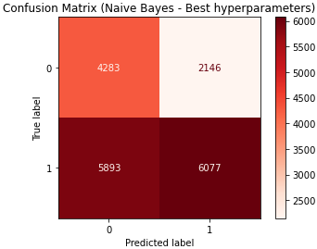
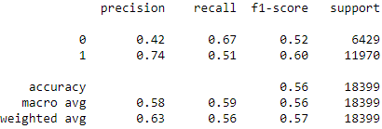
Machine Learning - Categories(2)
Bernoulli Naïve Bayes

Slide 14
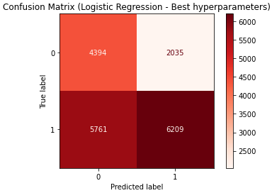
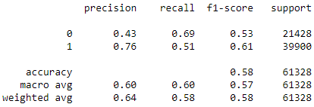
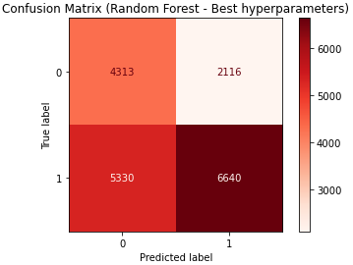
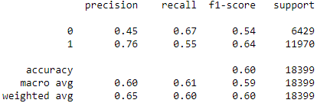
Machine Learning - Categories(3)
Logistic Regression
Random Forest

Slide 15
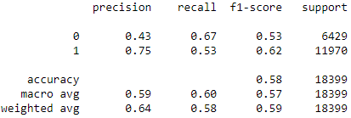
Machine Learning - Categories(4)
Keras

